Slide 1

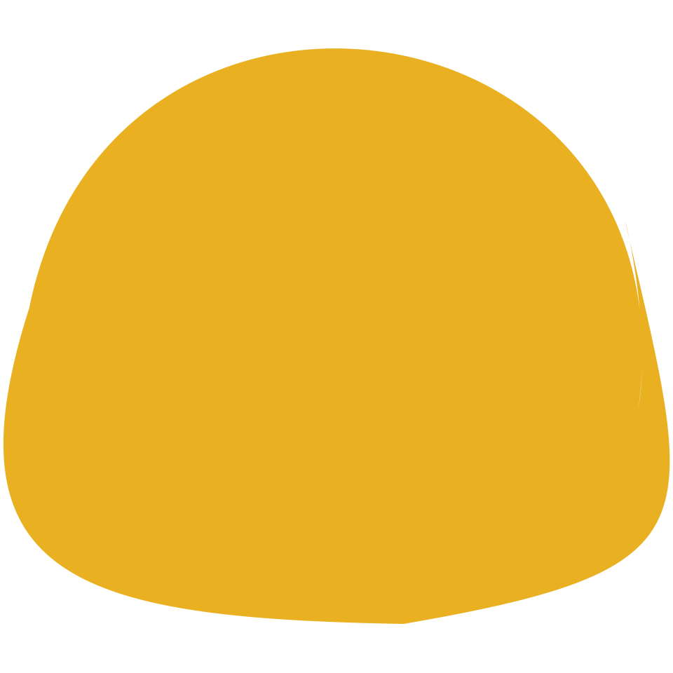













Raster Input
Layer-wise SVG Reconstruction (5 paths in total)
Raster Input SVG Output Editing color Editing eyes

Slide 2
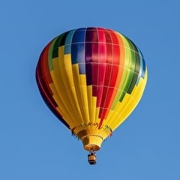



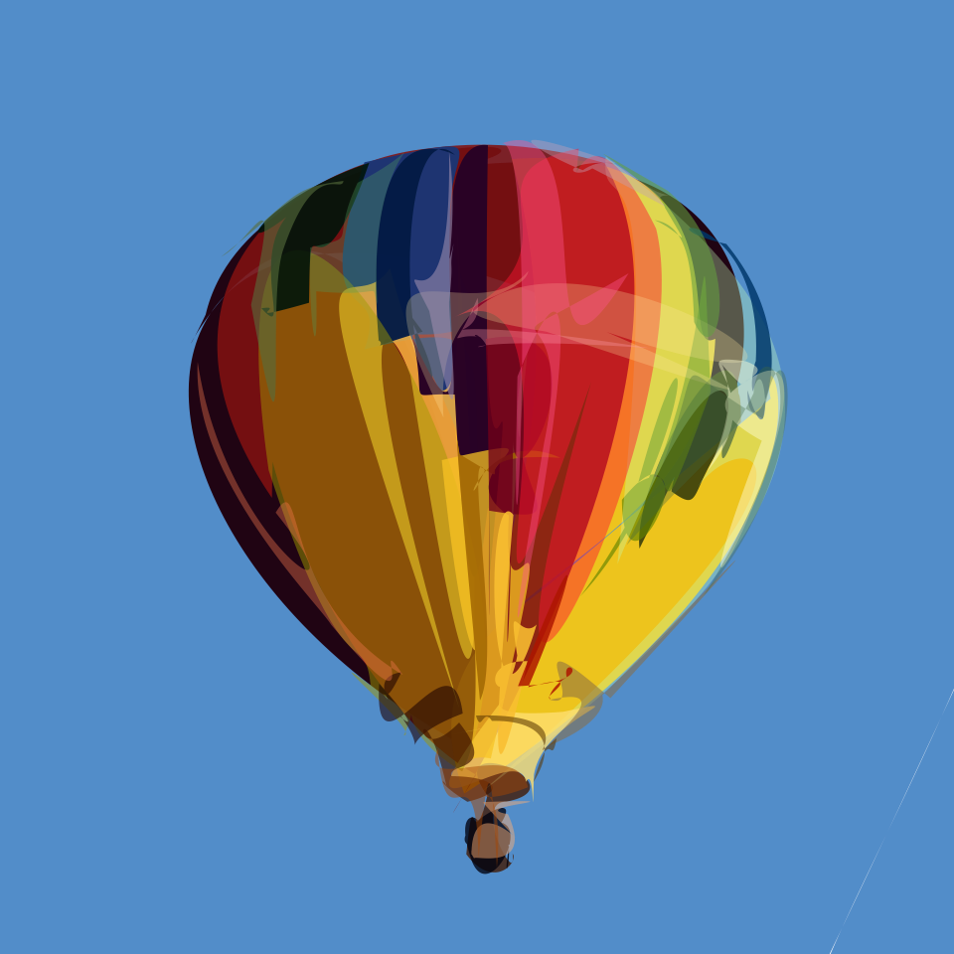
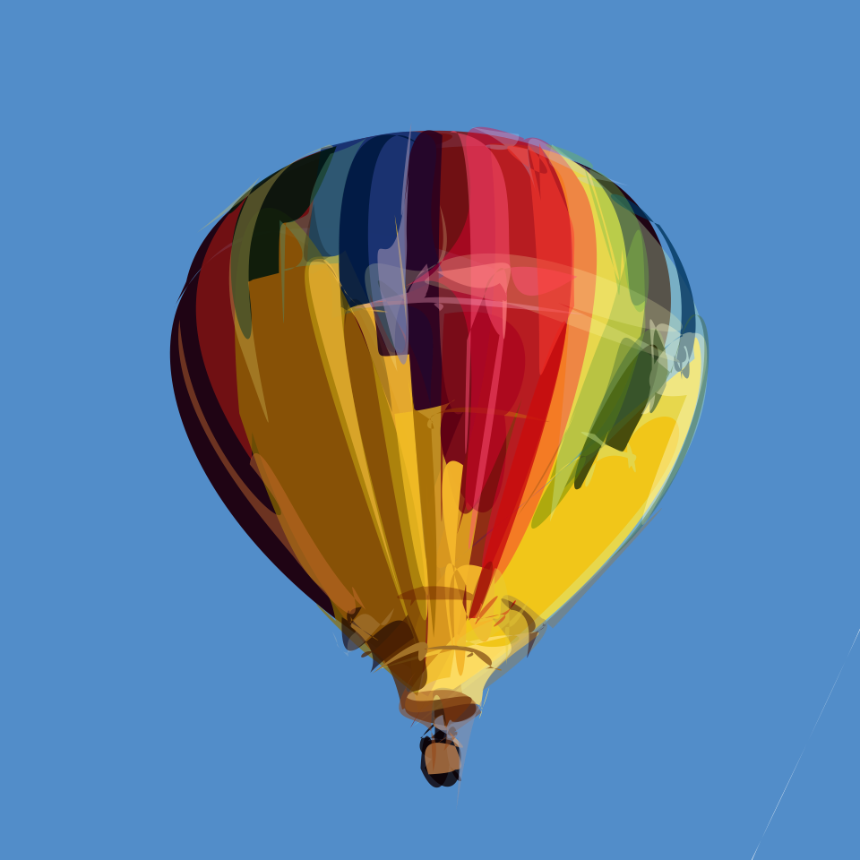
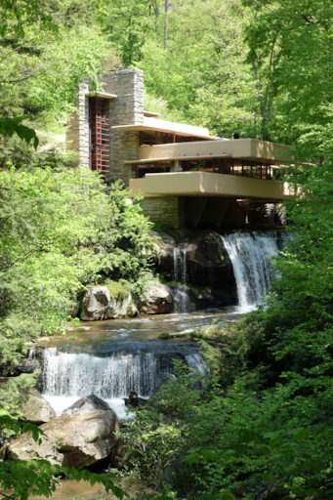
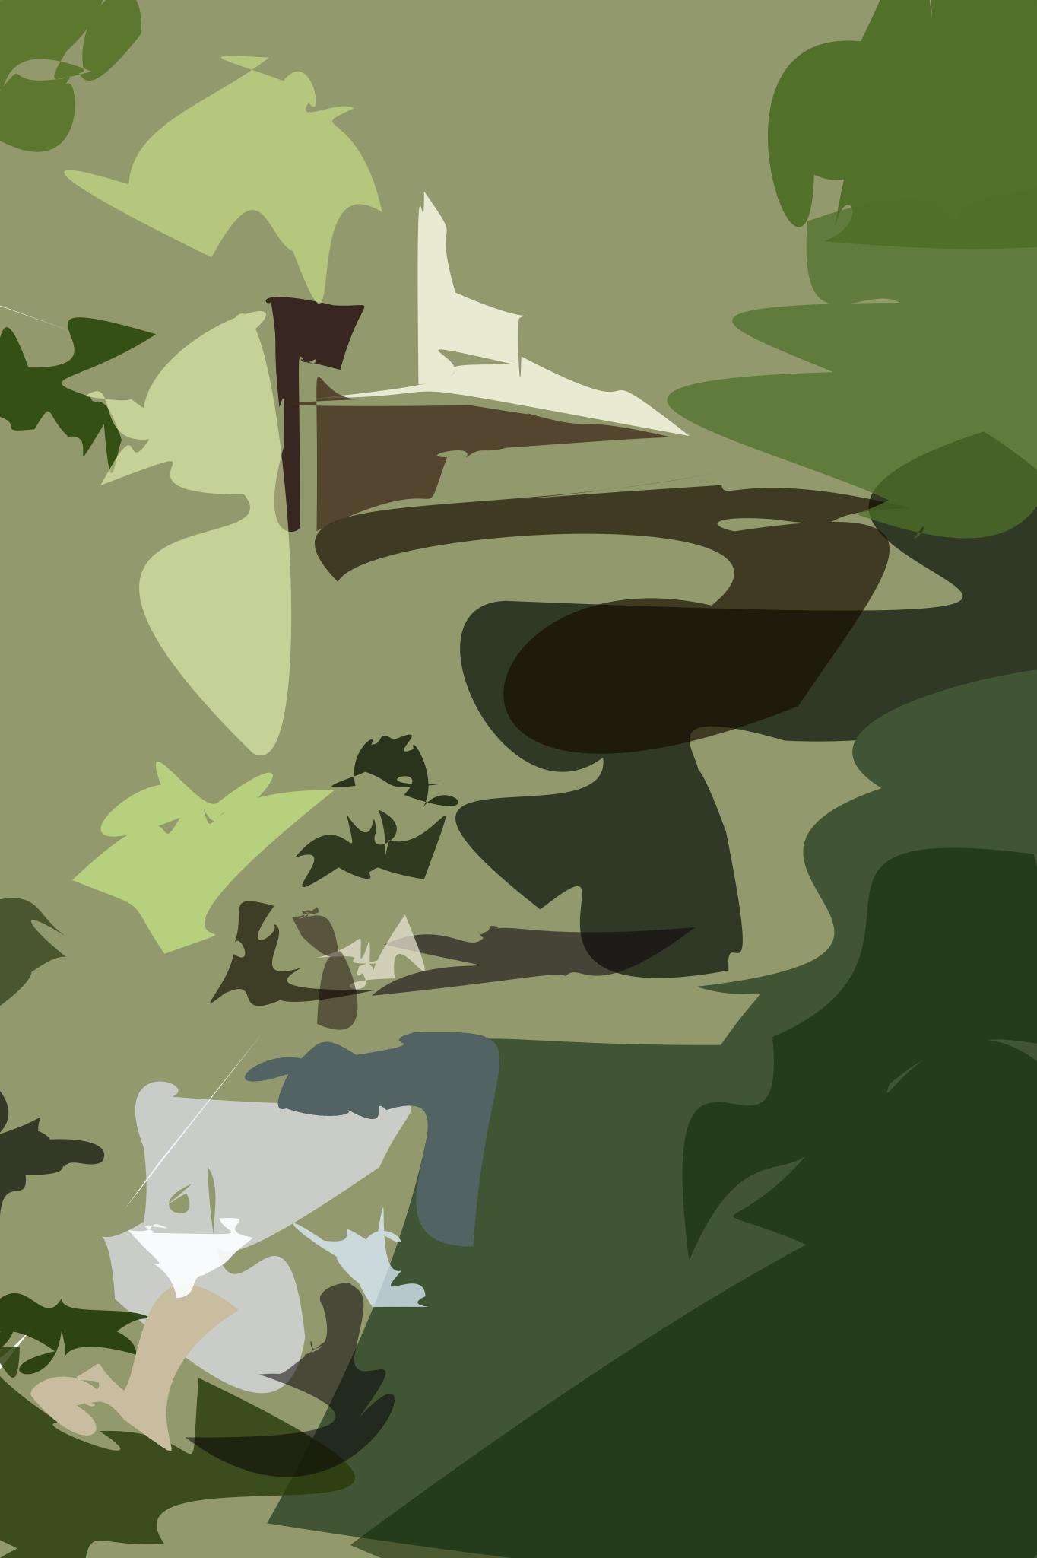
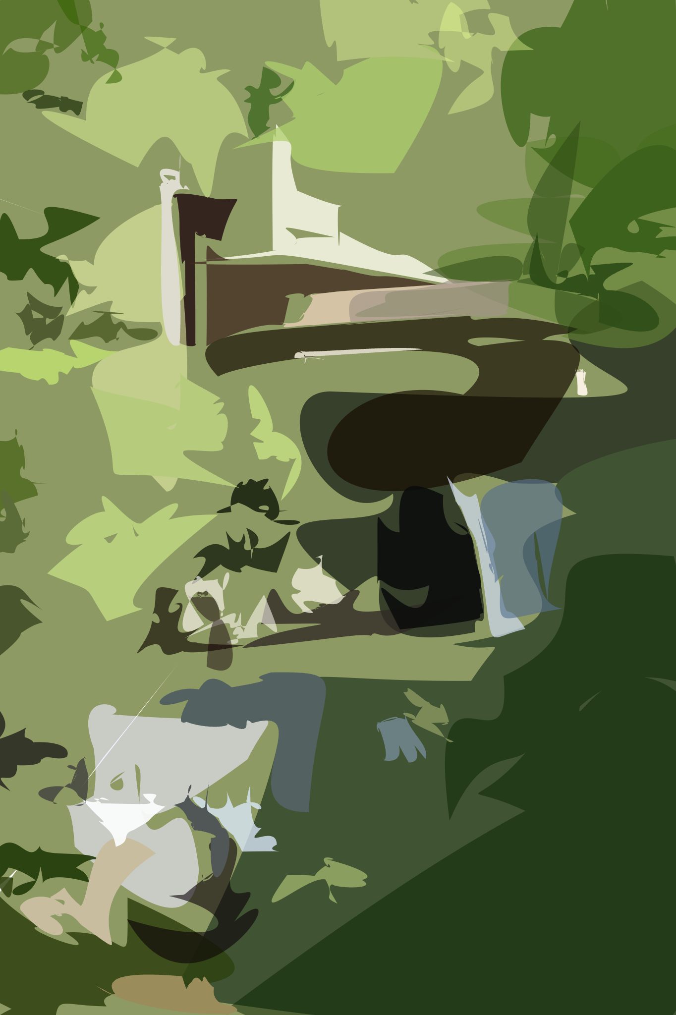
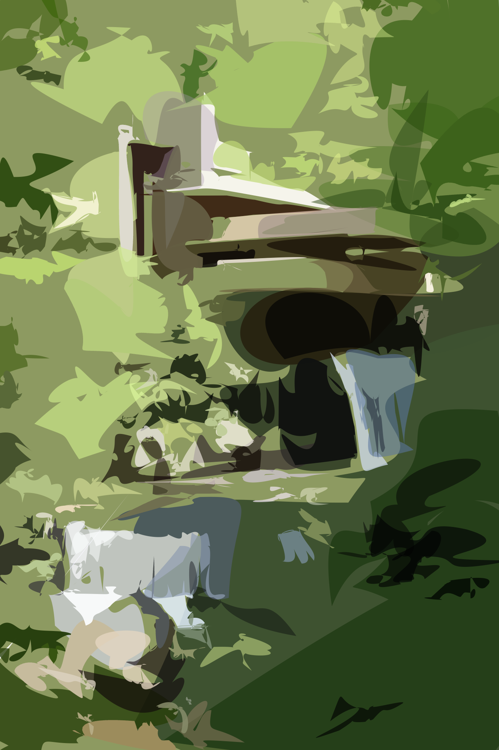
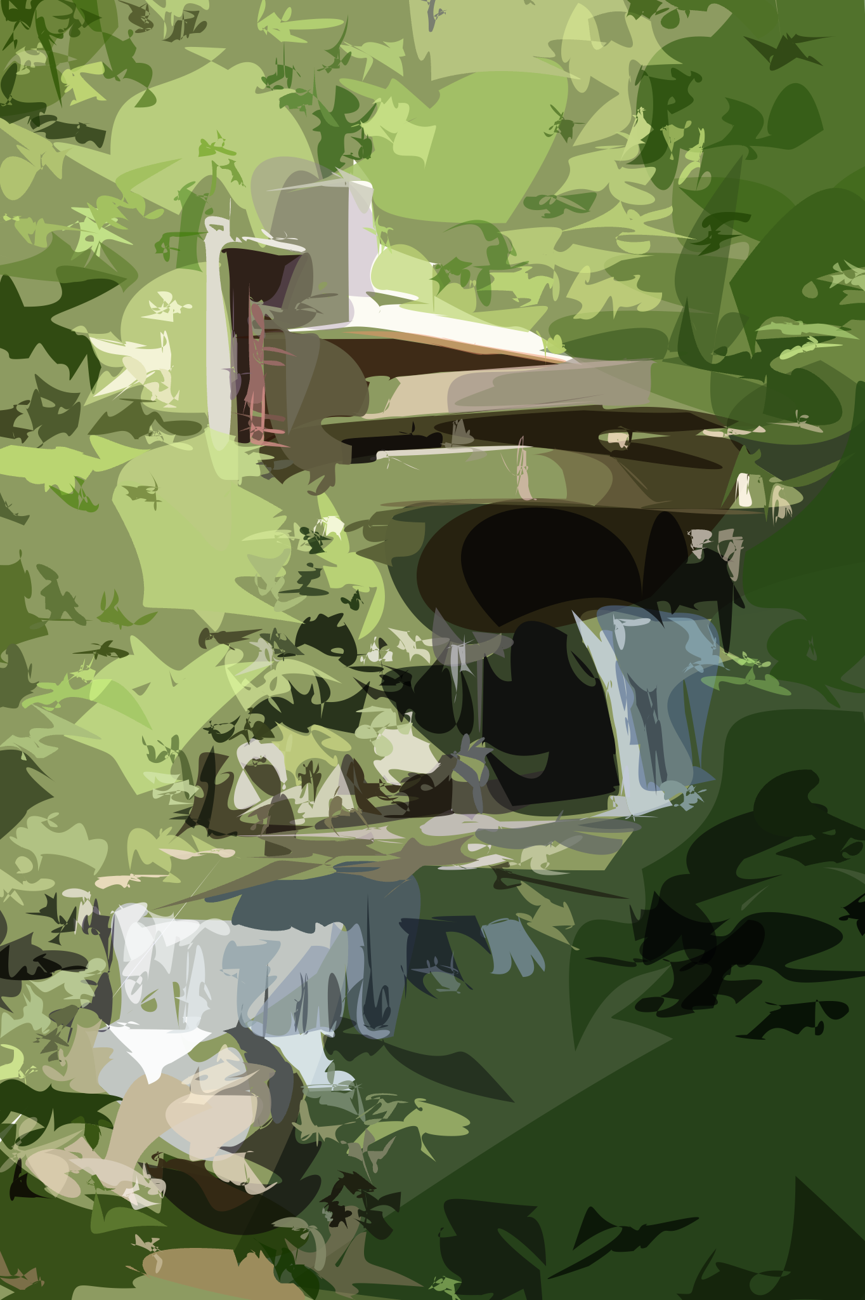
Raster Input
Layer-wise SVG Vectorization (from left to right)

Slide 3


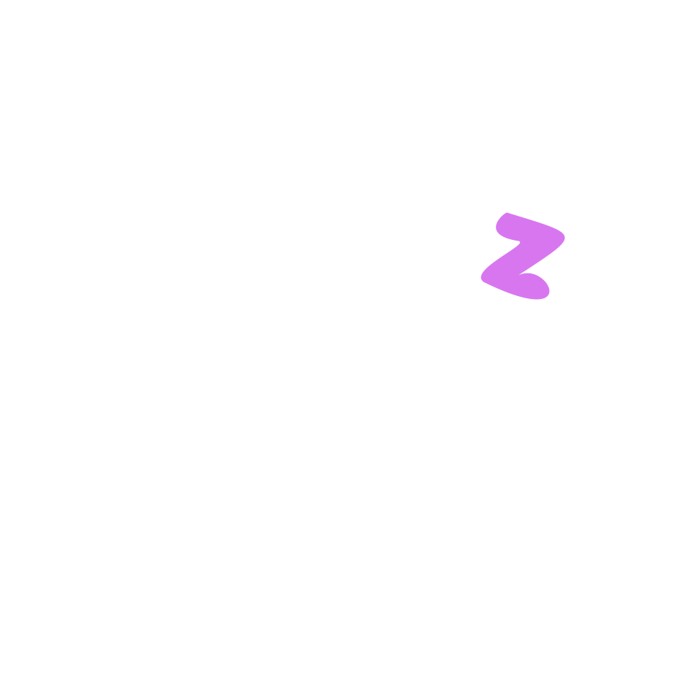






Slide 4







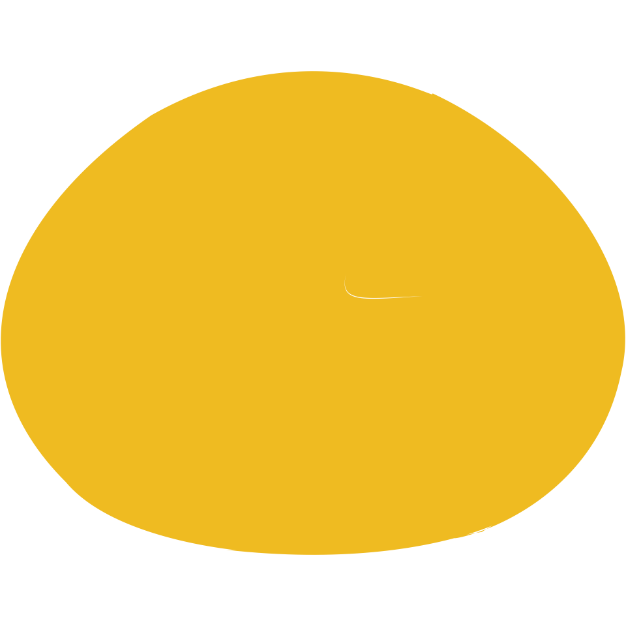








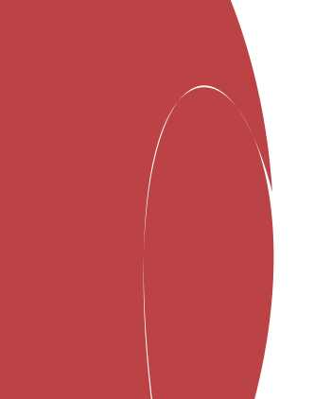
Circle Initialization
Random Initialization

Slide 5
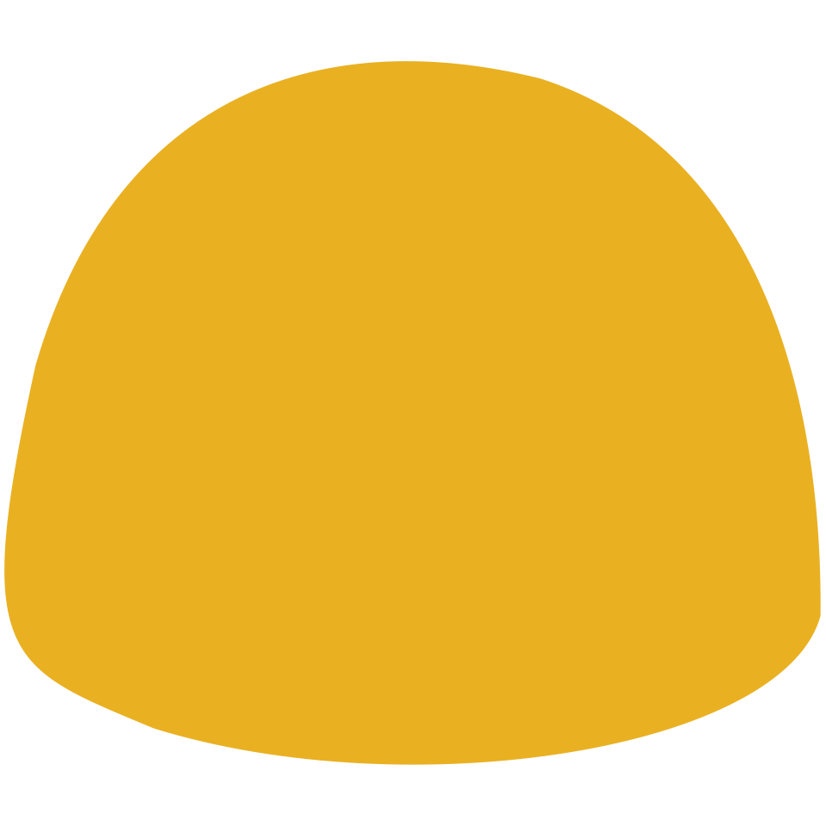





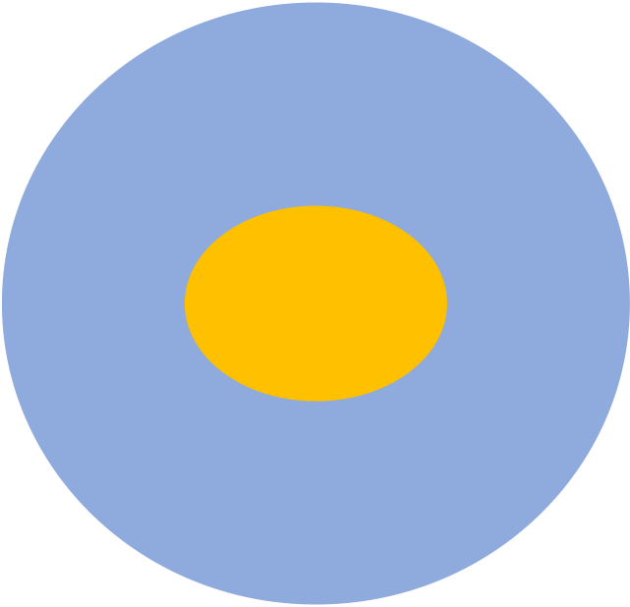

RGB(244,196,72)
RGB(225,179,83)
RGB(244,197,87)
RGB(93,134,194)
RGB(108,126,152)
RGB(86,132,194)
Target
MSE-Loss
SDF-Loss
Target
MSE-Loss
SDF-Loss
RGB (93,134,194)
RGB (86,132,194)
SDF loss

Slide 6









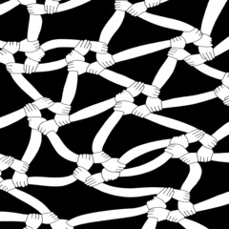

Emoji
Pics

Slide 7





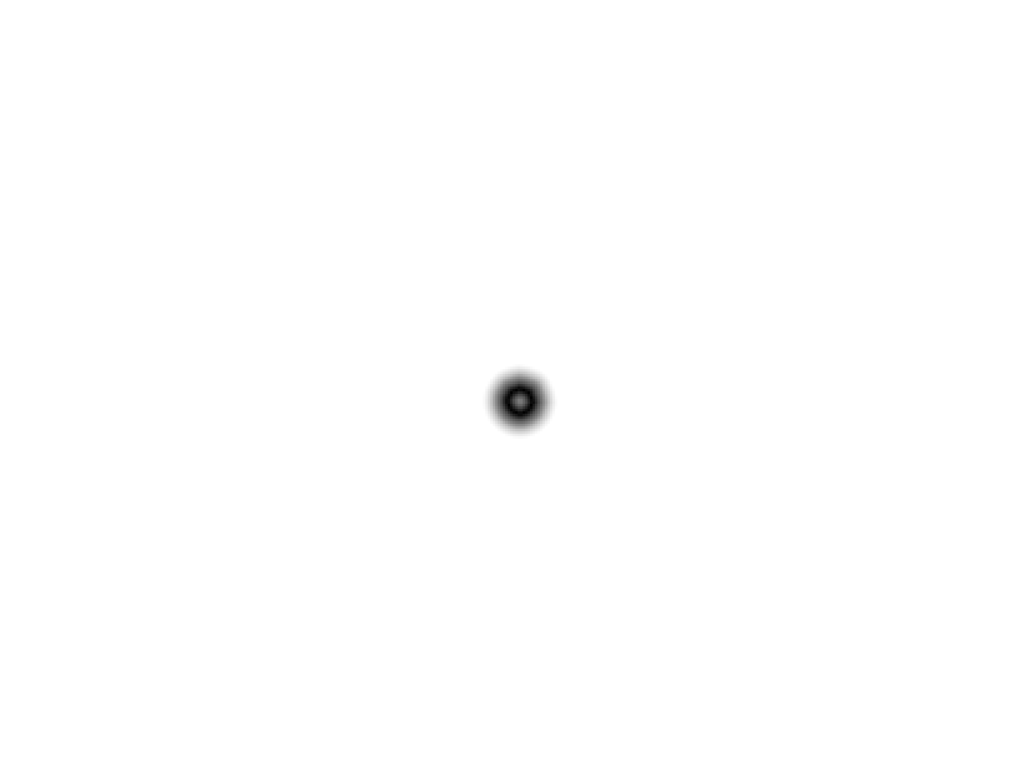
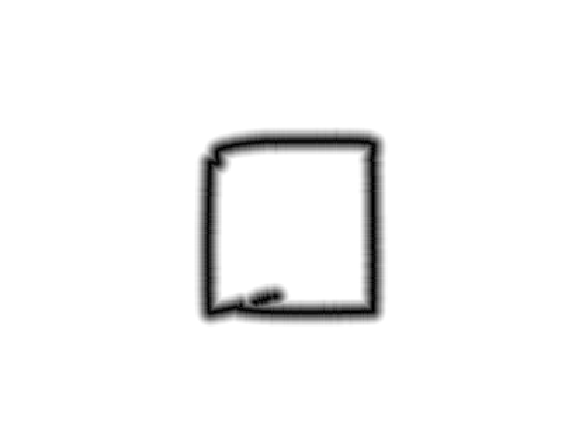
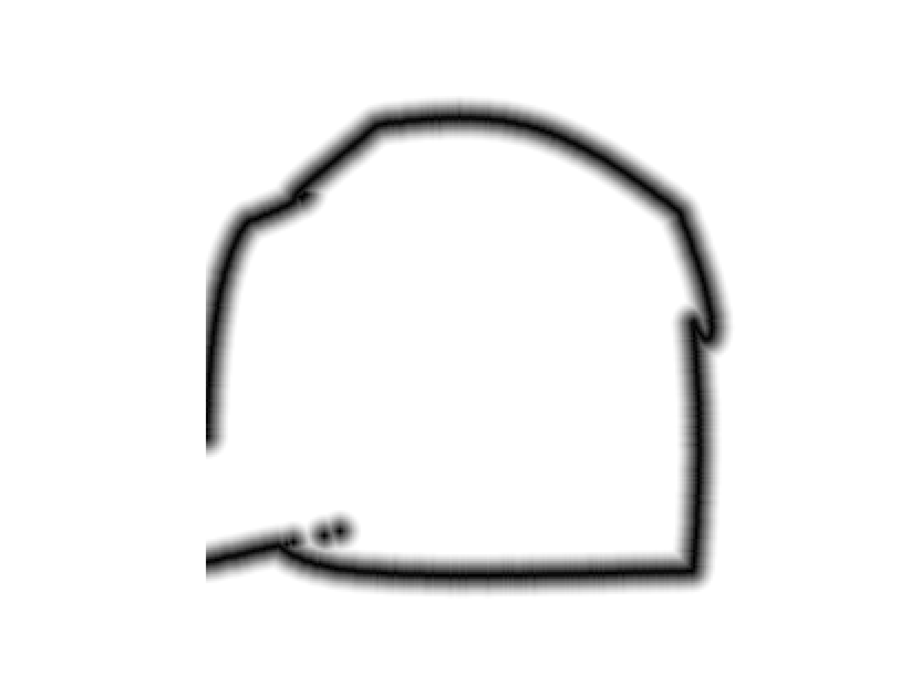
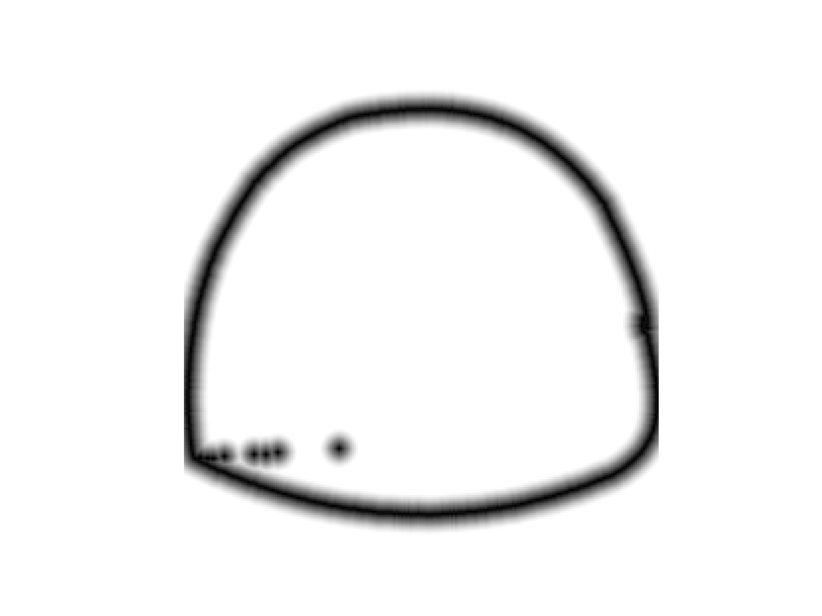
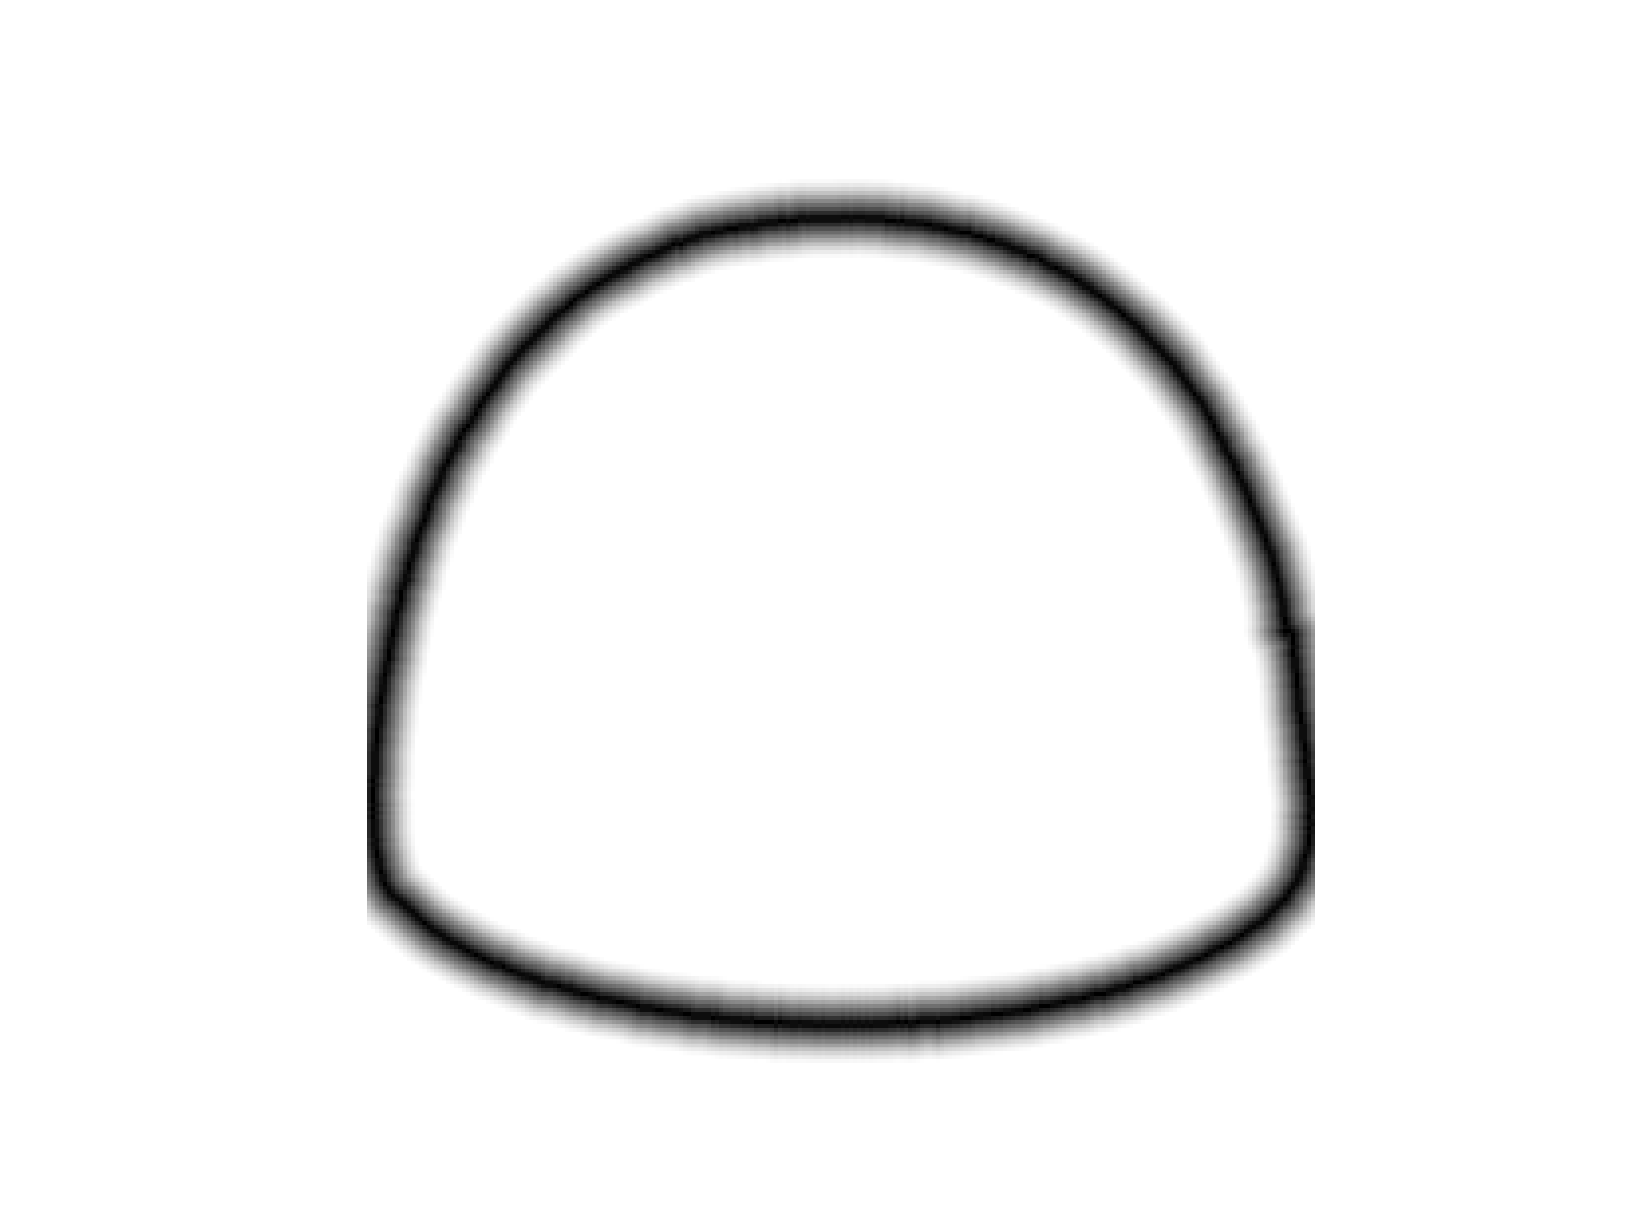
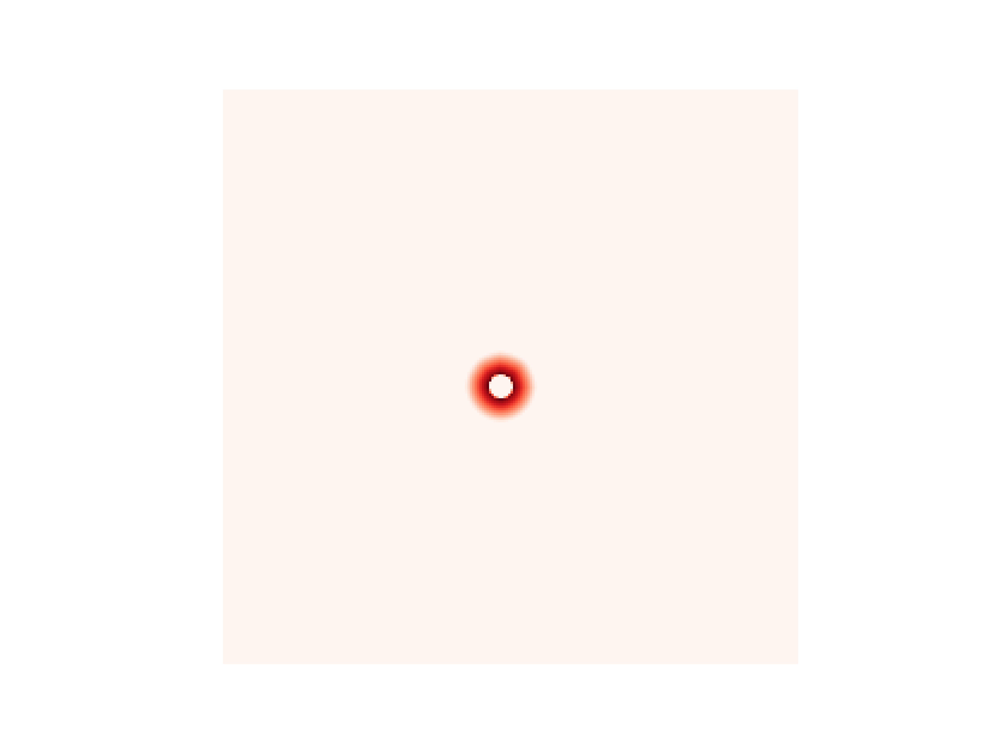
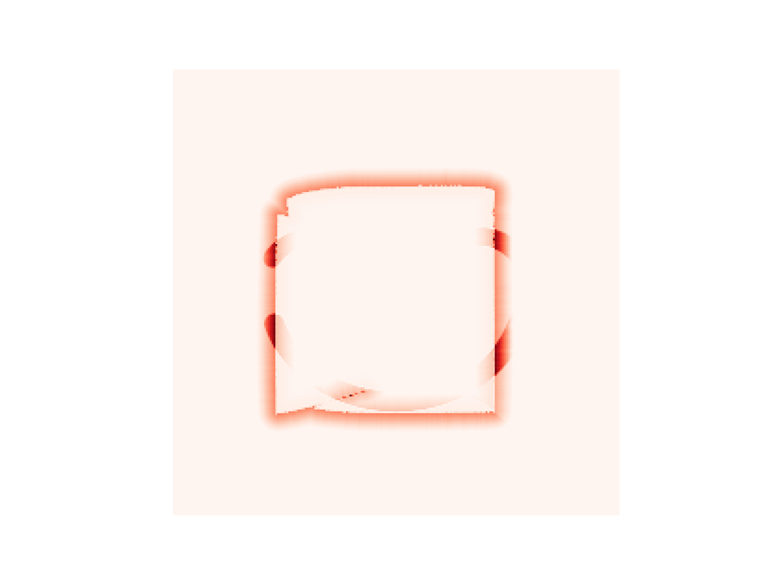
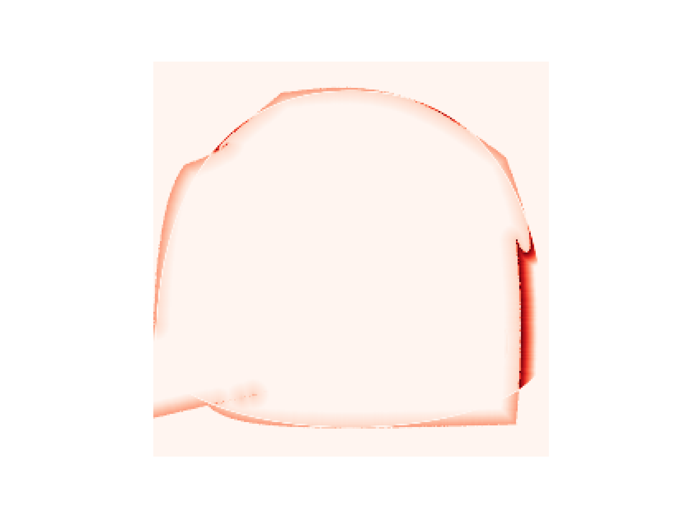
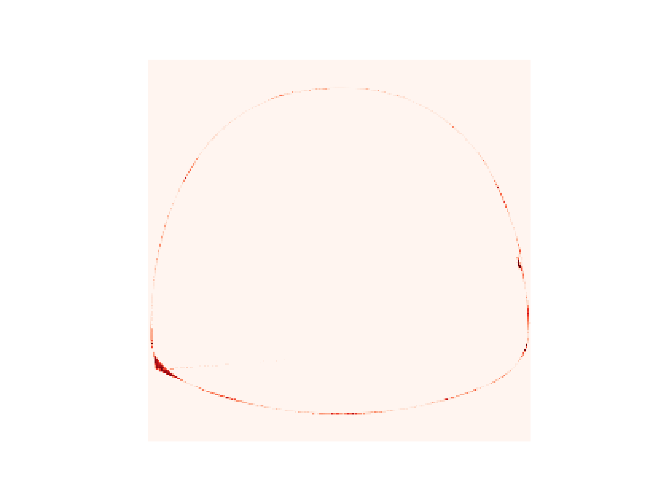
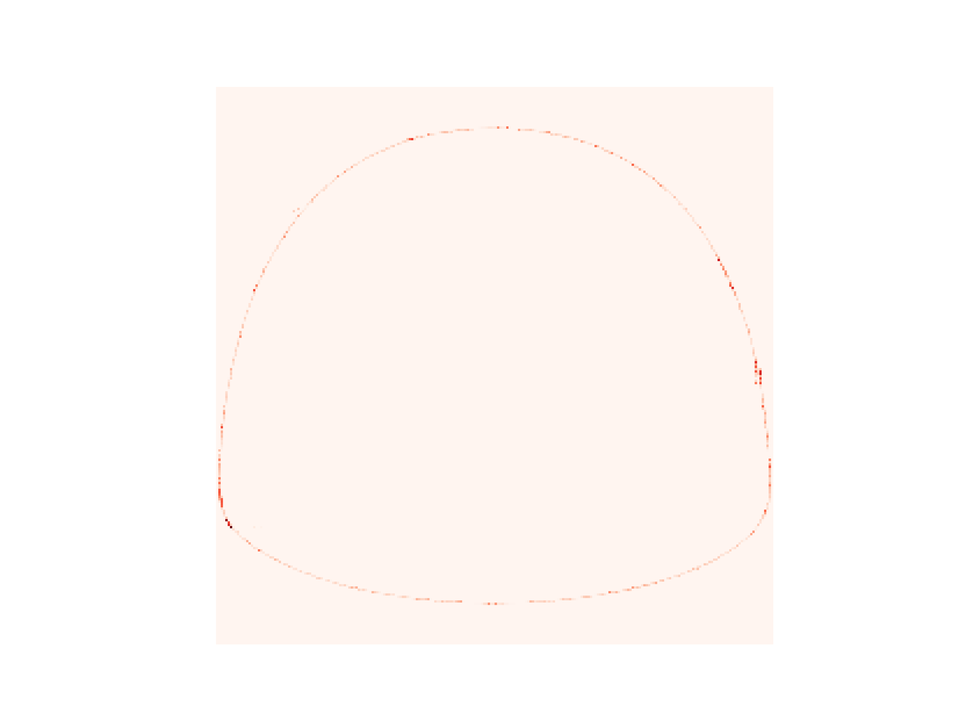
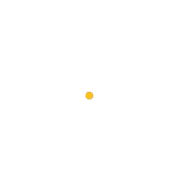
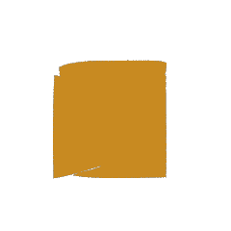
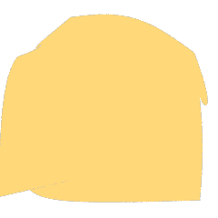
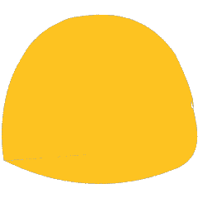
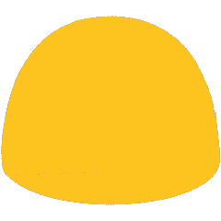
MSE loss
UD weight
UD loss
Shape
Iter. 1
Iter. 50
Iter. 100
Iter. 150
Iter. 200

Slide 8
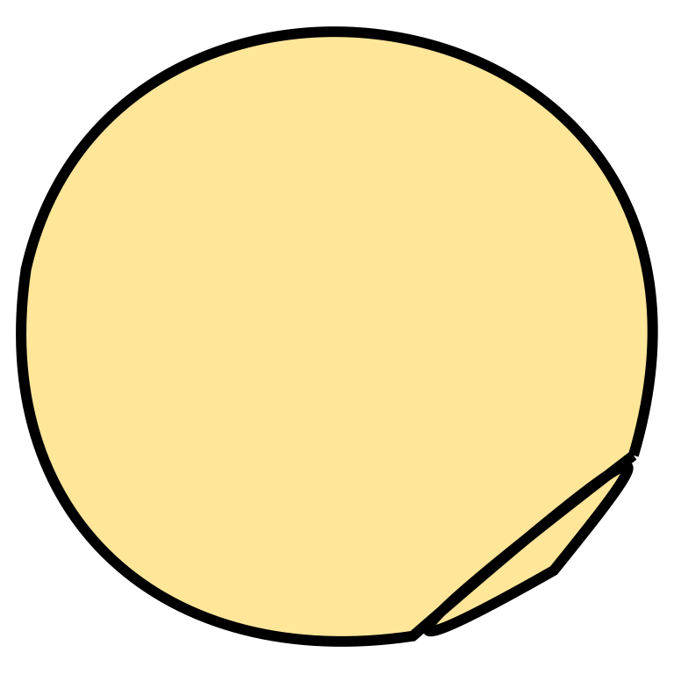
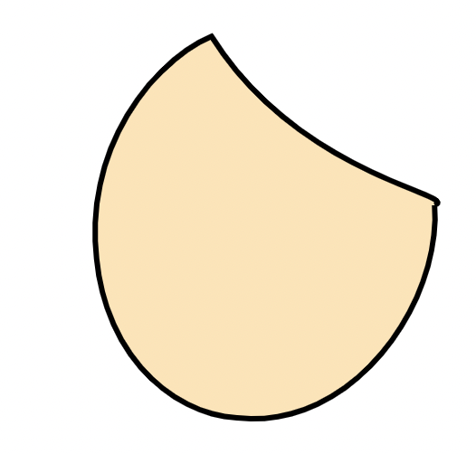
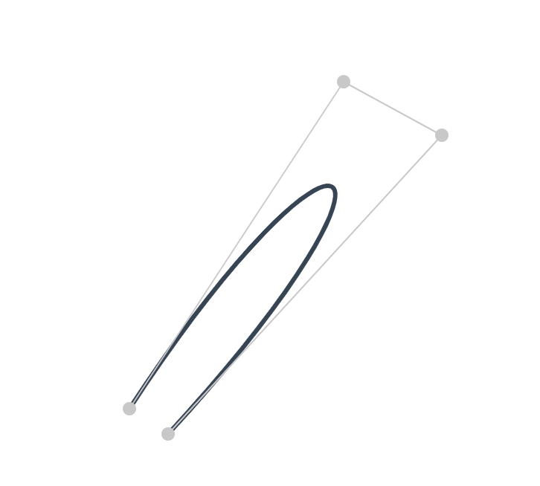
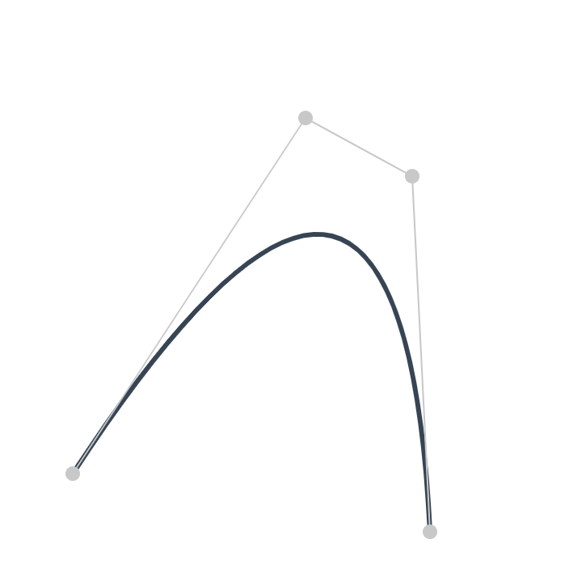


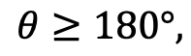
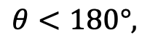
B
B
$$θ$$
C
$$θ$$
C
A
$$θ<180°,$$
A
$$θ≥180°,$$
D
Prone to self-interaction.
D
Prone to convex.

Slide 9
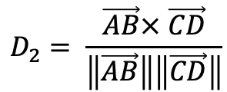
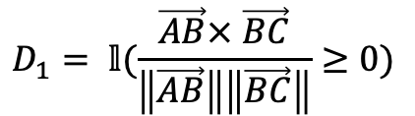



X-ing Loss to avoid self-intersection
B
B
$$θ$$
C
$$θ$$
C
$$\sin{θ}$$
$$D_{1}= 𝕝(\frac{\vec{AB}× \vec{BC}}{\left\|\vec{AB}\right\|\left\|\vec{BC}\right\|}≥0)$$
$$D_{2}= \frac{\vec{AB}× \vec{CD}}{\left\|\vec{AB}\right\|\left\|\vec{CD}\right\|}$$
A
D
A
$$ℒ=D_{1}\left(ReLU\left(−D2\right)\right)+(1−D1)(ReLU\left(D2\right))$$
D

Slide 10











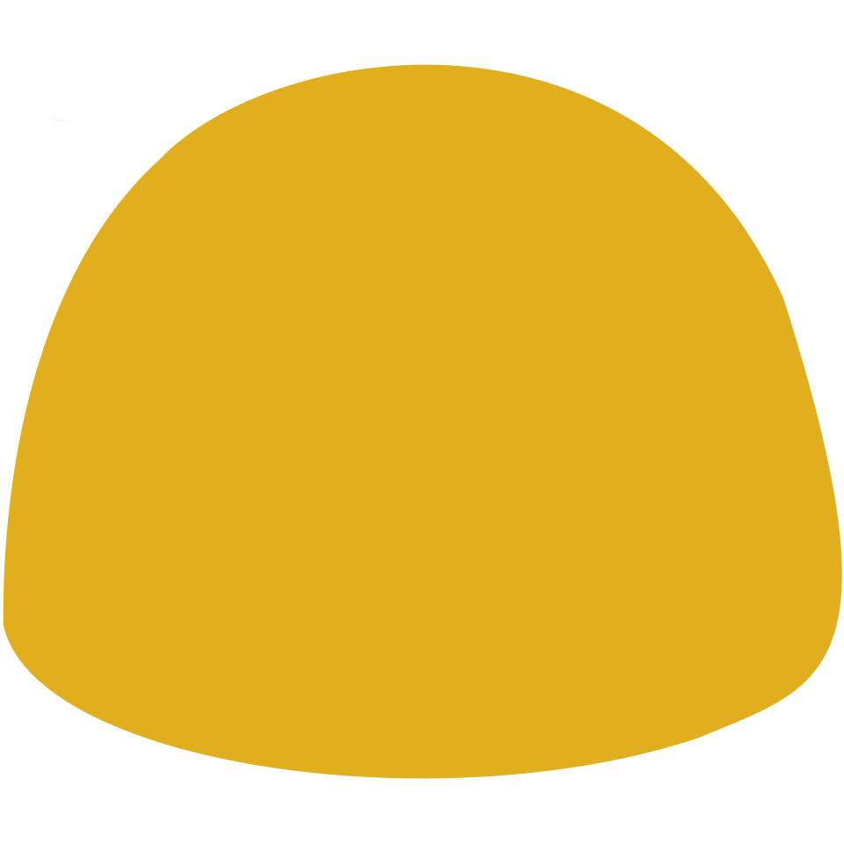















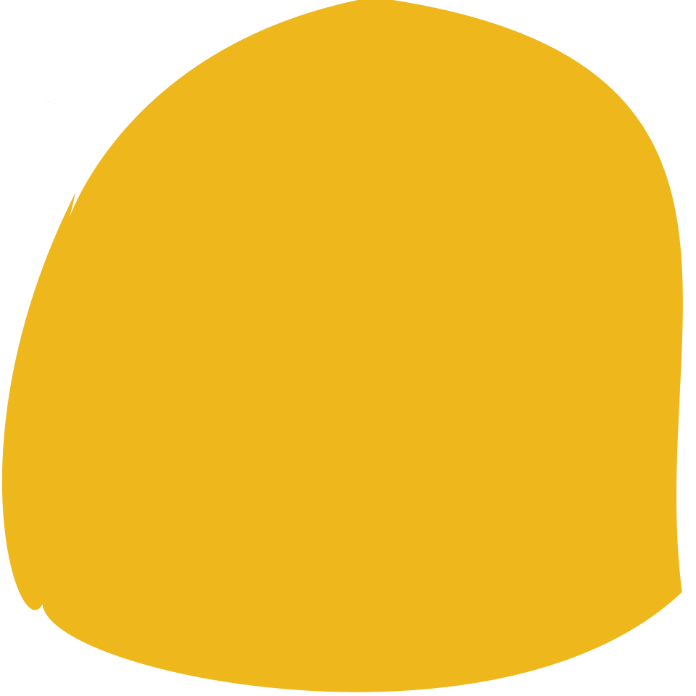

















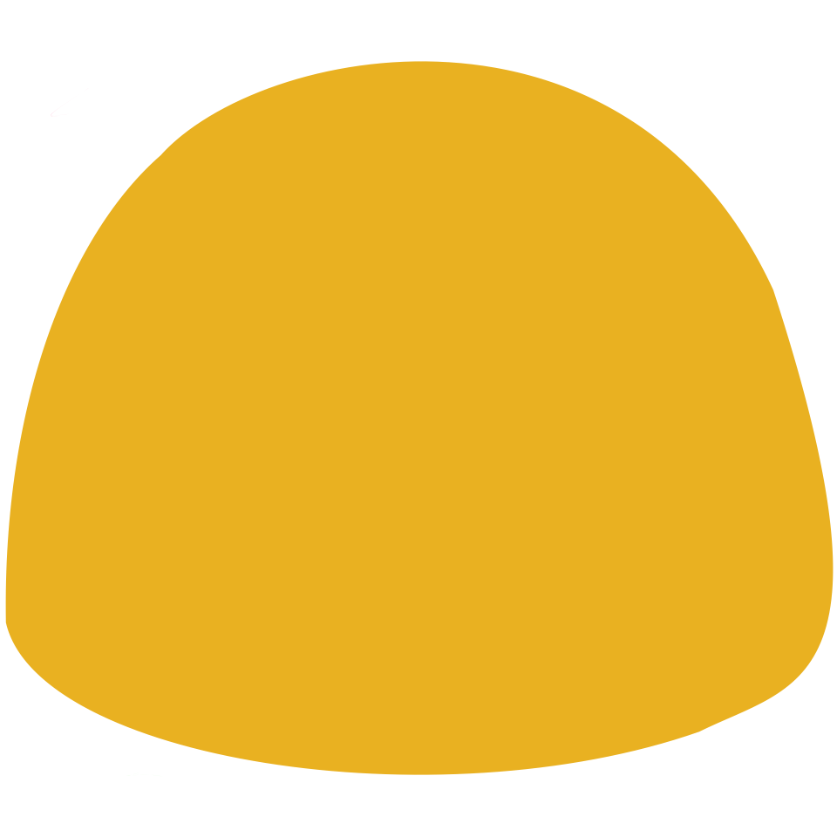





















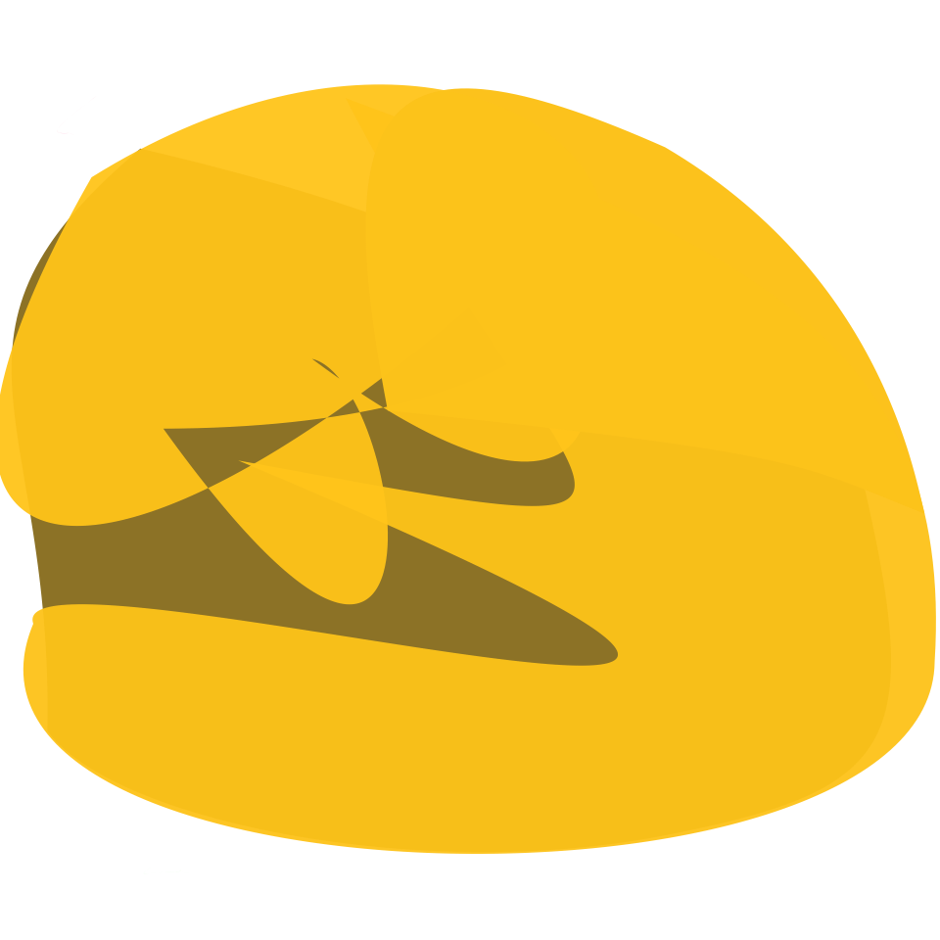


LIVE
DiffVG
LIVE
DiffVG
LIVE
DiffVG
LIVE
DiffVG
Raster Input
SVG out (from 1 to 8 paths)

Slide 11
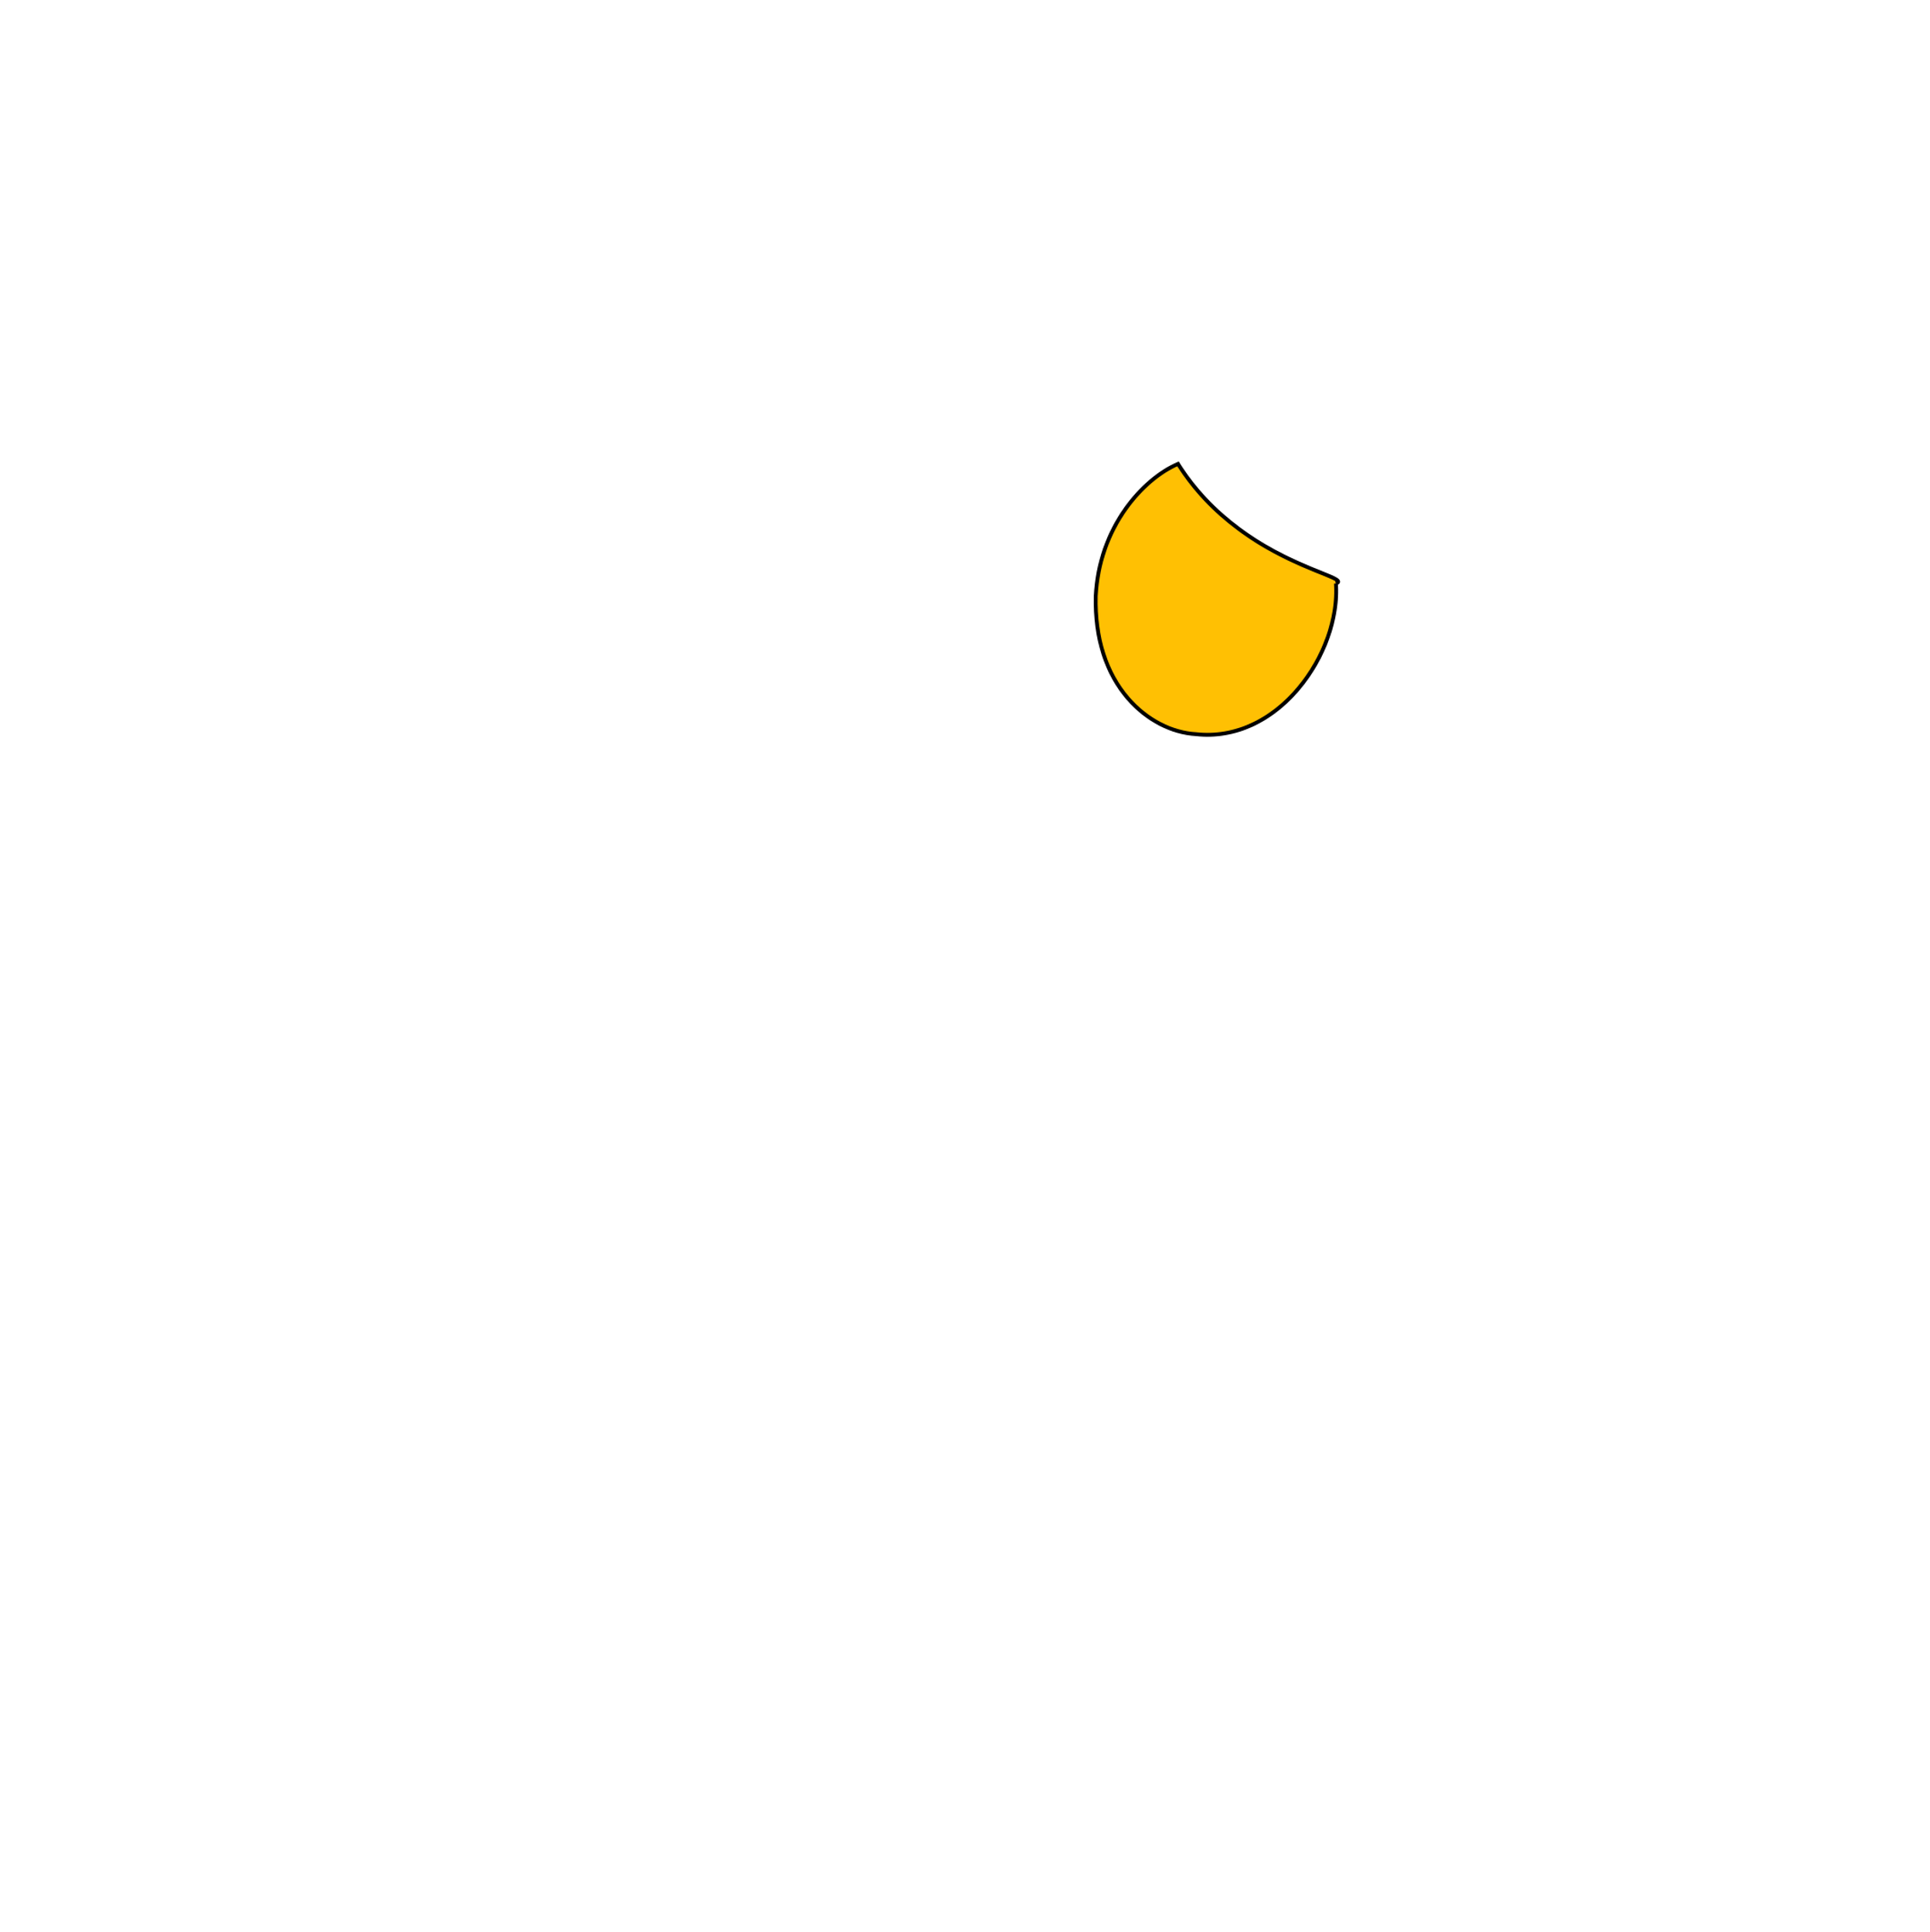

Slide 12



Slide 13








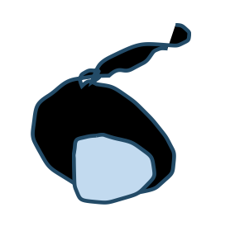


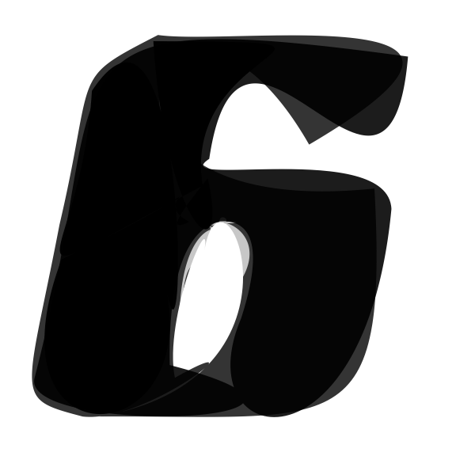





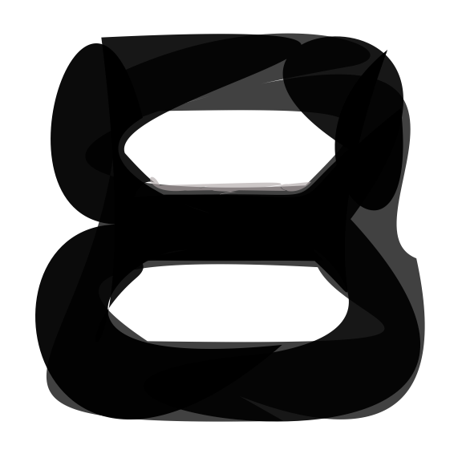
Input
ImageVAE
SVG-VAE
DeepSVG
Im2Vec
Ours

Slide 14




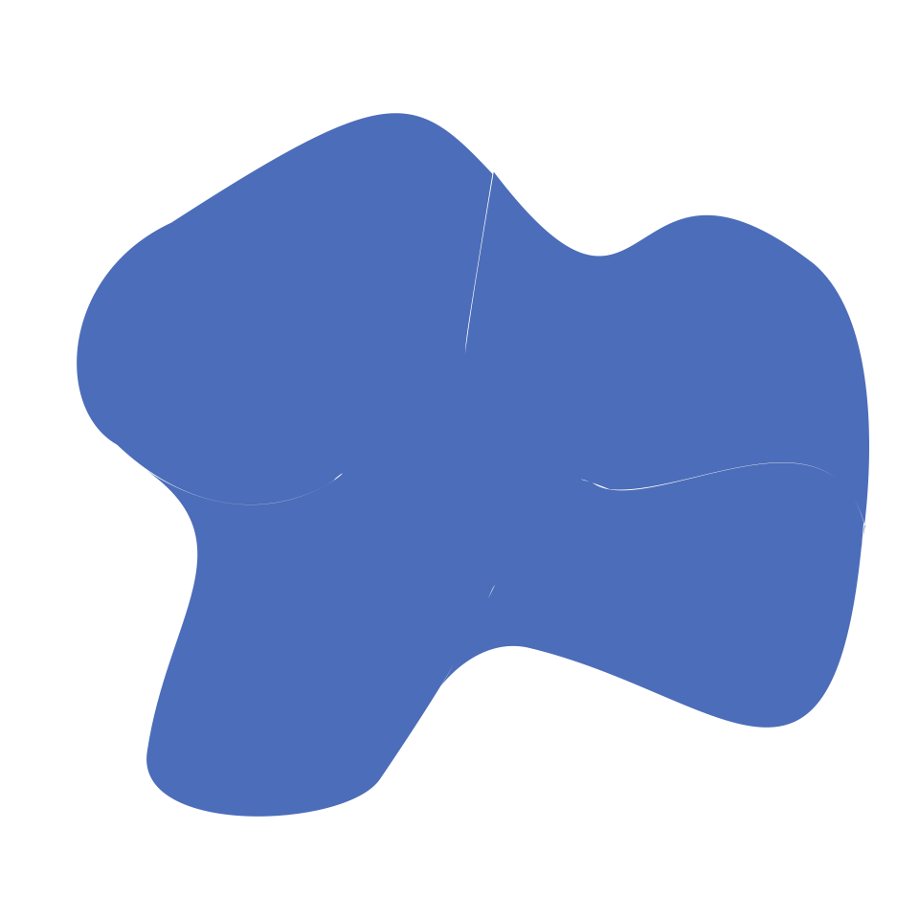

Input
Seg4
Seg8
Seg12
Seg16
Seg20

Slide 15
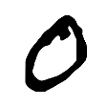
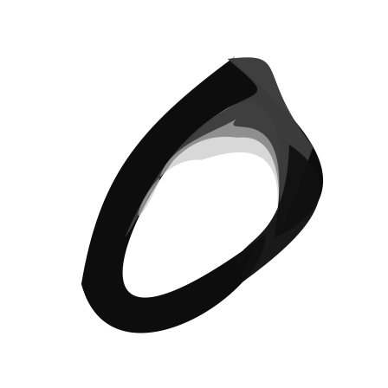
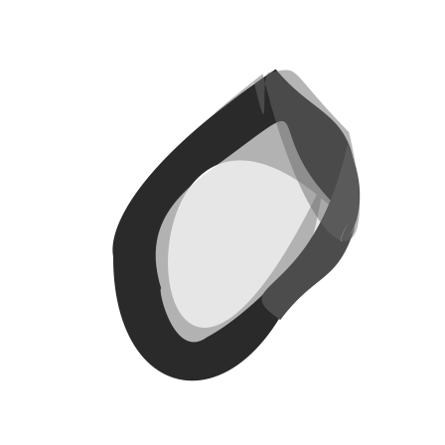








4
6
8
2

Slide 16









1 3 5 7 9
4
6
8
2

Slide 17







1
8
16
4
32
64
128

Slide 18



































DiffVG
Target
Painter
LIVE
N=1
N=4
N=8
N=16
N=32
N=64
DiffVG
Target
Painter
LIVE
N=32
N=64
N=128
N=256
N=512

Slide 19







Slide 20







Slide 21












Slide 22



Slide 23



Slide 24



Slide 25



Slide 26



Slide 27



Slide 28



Slide 29



Slide 30



Slide 31



Slide 32



Slide 33



Slide 34

$\left[\begin{matrix}1 & 2 \\ 3 & 4 \\ 5 & 6\end{matrix}\right]→$ $\left[\begin{matrix}5 & 6 \\ 3 & 4 \\ 1 & 2\end{matrix}\right]$

Slide 36




Slide 38




X-ing Loss to avoid self-intersection
B
B
$$θ$$
C
$$θ$$
C
$$\sin{θ}$$
$$D_{1}= 𝕝(\frac{\vec{AB}× \vec{BC}}{\left\|\vec{AB}\right\|\left\|\vec{BC}\right\|}≥0)$$
$$D_{2}= \frac{\vec{AB}× \vec{CD}}{\left\|\vec{AB}\right\|\left\|\vec{CD}\right\|}$$
A
D
A
$$ℒ=D_{1}\left(ReLU\left(−D2\right)\right)+(1−D1)(ReLU\left(D2\right))$$
D

Slide 39








Results Comparison on our dataset
Without Xing Loss
With Xing Loss (1e-2)
Without Xing Loss
With Xing Loss (1e-2)

Slide 40


Failure Cases
It follows the rules defined by the loss, but self-intersection still exist.
We need a stricter loss to constrain each segments to avoid (returning back lines)
Under the strict loss, more segments begin to help

Slide 41

Stricker?
B
B
$$θ$$
C
$$θ$$
C
A
D
A
Only allow 90 $θ$ degree segments (using sqrt function to constrain the loss range)
D

Slide 42






Stricker Xing Loss?
Without Xing Loss (1e-2)
Without Xing Loss v1
Without Xing Loss v2

Slide 43




Still some problems here…

Slide 59
A | B
B | C
A | B | C | D | E
C | D
D | E
E | A

